Slide 1
Progressive Web App

Slide 2
Introduction
_x000b_Progressive Web Apps are experiences that combine the best of the web and the best of apps. They are useful to users from the very first visit in a browser tab, no install required. As the user progressively builds a relationship with the app over time, it becomes more and more powerful. It loads quickly, even on flaky networks, sends relevant push notifications, has an icon on the home screen, and loads as a top-level, full screen experience.
Building a progressive web app has now become a web development trend every enterprise wants to follow. Big players such as Twitter and Flipboard recently launched their progressive web apps to deliver mobile experiences to users, without requiring them to actually install the app. In this article, you will learn how to build a progressive web app using React. So, let’s get started.

Slide 3
What is a Progressive Web App?
Progressive - Works for every user, regardless of browser choice because it's built with progressive enhancement as a core tenet.
Responsive - Fits any form factor: desktop, mobile, tablet, or whatever is next.
Fresh - Always up-to-date thanks to the service worker update process.
Safe - Served via HTTPS to prevent snooping and to ensure content hasn't been tampered with.

Slide 4
Installable - Allows users to add apps they find most useful to their home screen without the hassle of an app store.
Connectivity independent - Enhanced with service workers to work offline or on low-quality networks.
App-like - Feels like an app, because the app shell model separates the application functionality from application content .

Slide 5
Develop A Progressive Web App
Progressive Web Apps (PWAs) have rapidly grown in popularity as essentially fast, performance-based web applications streamlined for delivering mobile app-like experiences. PWAs are built using front-end technologies like HTML, CSS, and JavaScript to create a level of usability and performance that’s in parity with native mobile applications. They are responsive, consume lesser data and storage space, and supports push notifications and offline usage in the browser.

Slide 6
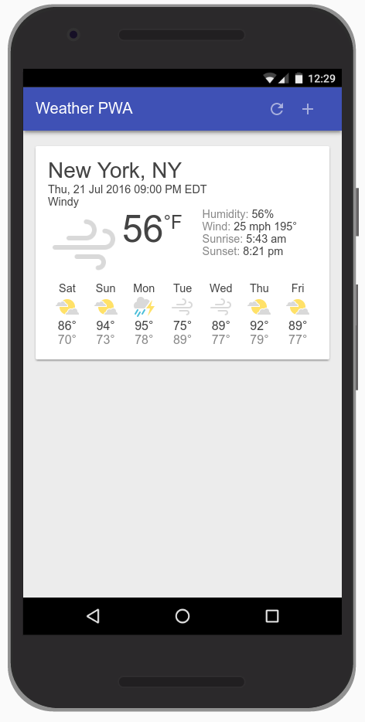
What we will build
Today, we are going to build a Weather web app using Progressive Web App techniques. Your app will:
Utilize and demonstrate the above principles of Progressive Web Apps.
Use live weather data.
Provide app-like interactions to allow the user to add cities.

Slide 7

What we will learn
How to design and construct an app using the "app shell" method.
How to make your app work offline.
How to store data for later offline use.

Slide 8
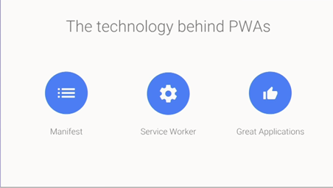
What we will need
A recent version of Chrome. Note, this works in other browsers as well, but we'll be using a few features of the Chrome DevTools to better understand what's happening at the browser level.
Web Server from chrome or own web server.
Basic Knowledge of HTML,CSS,JavaScript and Dev Tools.

Slide 9
Let’s Go to Start
First, generate a React app with create-react-app. To do so, you need to run the following commands:
    npm install -g create-react-app
    create-react-app pwa-app
Now install React Router
    cd pwa-app
    npm install --save react-router@3.0.5
Or
Write the code in Simple HTML and Javascript.

Slide 10
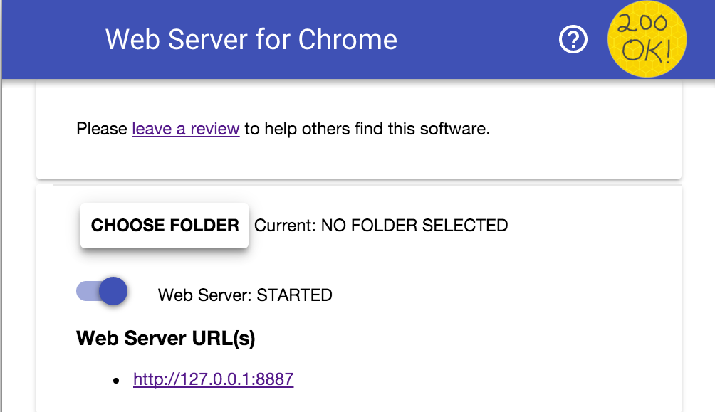
Install and Verify the web Server
Install and Verify the web Server by clicking on following:-
    Install Web Service for Chrome
You'll see this dialog next, which allows you to configure your local web server:
Or

Slide 11
Click the choose folder button, and select the work folder. This will enable you to serve your work in progress via the URL highlighted in the web server dialog (in the Web Server URL(s) section).
Under Options, check the box next to "Automatically show index.html“.
Then stop and restart the server by sliding the toggle labeled "Web Server: STARTED" to the left and then back to the right

Slide 12
Architect your App Shell
The app's shell is the minimal HTML, CSS, and JavaScript that is required to power the user interface of a progressive web app and is one of the components that ensures reliably good performance. Its first load should be extremely quick and immediately cached. "Cached" means that the shell files are loaded once over the network and then saved to the local device. Every subsequent time that the user opens the app, the shell files are loaded from the local device's cache, which results in blazing-fast startup times
App shell architecture separates the core application infrastructure and UI from the data. All of the UI and infrastructure is cached locally using a service worker so that on subsequent loads, the Progressive Web App only needs to retrieve the necessary data, instead of having to load everything.cd pwa-app
A service worker is a script that your browser runs in the background, separate from a web page, opening the door to features that don't need a web page or user interaction.

Slide 13
Implement your App Shell
There are multiple ways to get started with any project, in this case, to keep our project as simple as possible and concentrate on Progressive Web Apps, we've provided you with all of the resources you'll need.
Now we will add the core component (HTML code).

Slide 14
Use service workers to pre-cache the App Shell
Progressive Web Apps have to be fast, and installable, which means that they work online, offline, and on intermittent, slow connections. To achieve this, we need to cache our app shell using service worker, so that it's always available quickly and reliably.
A service worker is a script that your browser runs in the background, separate from a web page, opening the door to features that don't need a web page or user interaction. Today, they already include features like push notifications and background sync. In the future, service workers might support other things like periodic sync or geofencing. The core feature discussed in this tutorial is the ability to intercept and handle network requests, including programmatically managing a cache of responses.

Slide 15
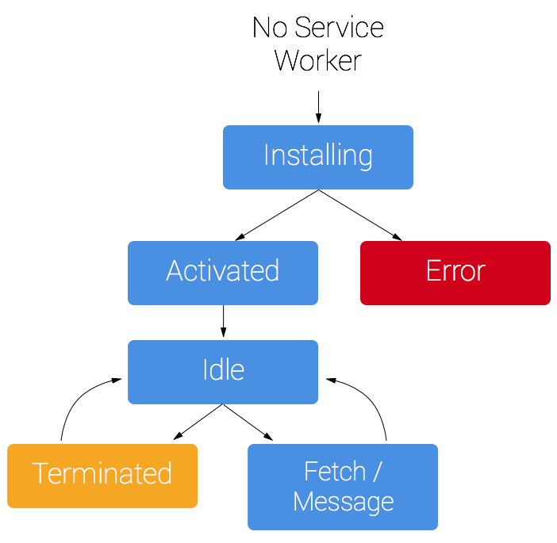
Service Worker

Slide 16
Registered The Service Worker
if ('serviceWorker' in navigator) {
navigator.serviceWorker .register('./service-worker.js') .then(function() {
console.log('Service Worker Registered');
});
}
After complete service worker code open the service worker pane from chrome.

Slide 17
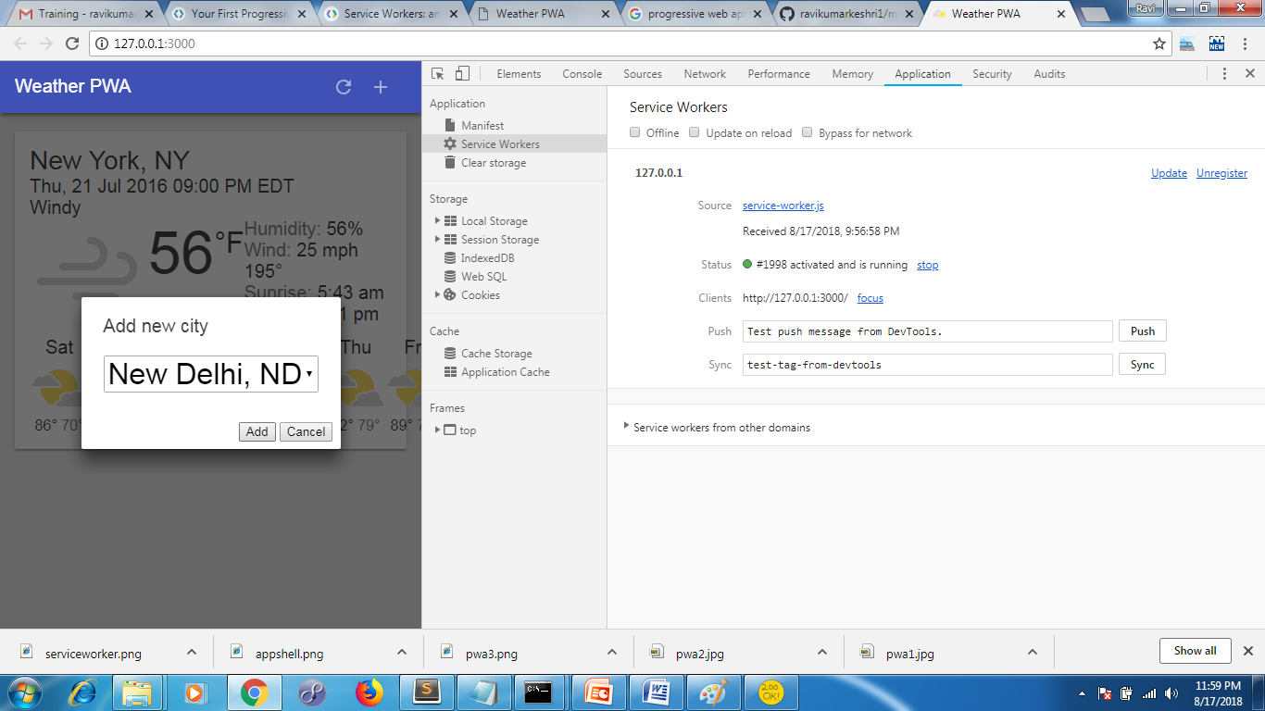
Service worker pane

Slide 18
Support native integration
Now Create the manifest.json file to implement the native support.
The web app manifest is a simple JSON file that gives you, the developer, the ability to control how your app appears to the user in the areas that they would expect to see apps (for example the mobile home screen), direct what the user can launch and more importantly how they can launch it.
Using the web app manifest, our web app can:cd pwa-app
    Have a rich presence on the user's Android home screen
    Be launched in full-screen mode on Android with no URL bar
    Control the screen orientation for optimal viewing
    Define a "splash screen" launch experience and theme color for the site

Slide 19
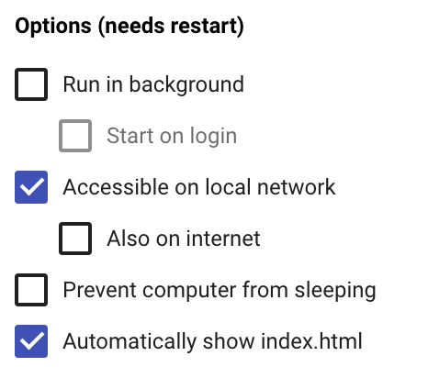
For Local Network
On Web Server for Chrome configuration dialog, select the Accessible on local network option:
Toggle the Web Server to STOPPED and back to STARTED. You'll see a new URL which can be used to access your app remotely.
Now, access your site from a mobile device, using the new URL.

Slide 20
Deploy to a secure host and celebrate
For App deployment we can use firebase.
Create a Firebase account at https://firebase.google.com/console/
Install the Firebase tools via npm: npm install -g firebase-tools
Now execute :- $ sudo firebase login from terminal.
$ sudo firebase init
$ sudo firebase deploy.

Slide 21
Thanks…

